Slide 1

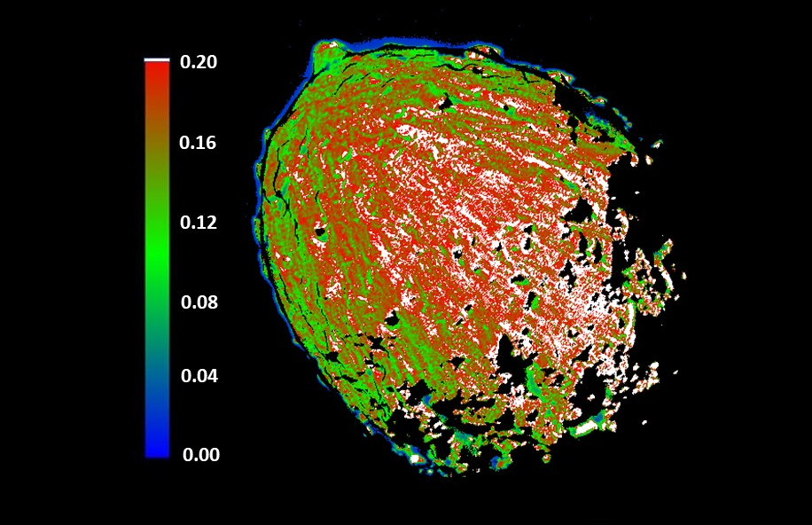
Pre-impact Albedo Map and Photometric Properties of the (65803) Didymos Asteroid Binary System from DART and Ground-based Data
Bonnie J. Buratti
Background: The development of mitigation strategies for deflecting or disrupting a Near –Earth Object (NEO) on a collision trajectory to Earth is a key component of NASA’s Planetary Defense Program. The Double Asteroid Redirection Test (DART) Mission was NASA’s first demonstration of the kinetic impactor technique. This study defines the pre-collision surface properties of Dimorphos, the impact target.
Data & Results: The roughness, albedo, phase curve and other properties of Dimorphos are typical of the S-family of asteroids.
Significance: These results provide a baseline for comparison with results from the European Space Agency’s Hera mission, which will closely scrutinize the post-impact Dimorphos in 2026, leading to an understanding of the quantitative effects of the kinetic impactor mitigation strategy.
The figure shows the normal reflectance of Dimorphos computed from a calibrated, closest-approach DART image of Dimorphos, the companion of Didymos, corrected for all the effects of viewing geometry. The higher albedo streaks are not an artifact; they are possibly due to the presence of smaller, brighter particles.
Citation: B. J. Buratti, J. Pittichová, I. Mishra, J. K. Hillier, J. A. Mosher, S. R. Chesley, J. M. Sunshine, O. Barnouin, C. M. Ernst, R. T. Daly, J-Y Li, A. F. Cheng, A. S. Rivkin (2024) Planet. Sci. J. 5, id.83. DOI 10.3847/PSJ/ad2b60
This work was supported by the DART Participating Scientist Program
© 2024 California Institute of Technology. Government sponsorship acknowledged.
Notes:
1
You may add comments here to clarify the work or the results.

